Slide 1
ISSUES AND CHALLENGES IN
PROJECT MANAGEMENT
Dr A. L. SANGAL
Professor & Head
Computer Science & Engineering Department
NIT JALANDHAR

Slide 2



Move From Conceptual to Physical
Envisioning
Resources
Schedule
Features
Planning
Resources
Schedule
Features

Slide 3
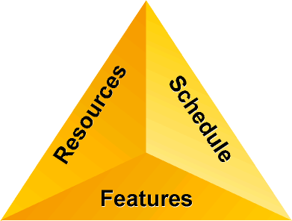

Slide 4
 | Certain | Selected | Flexible
Resources
Schedule
Features

Slide 5
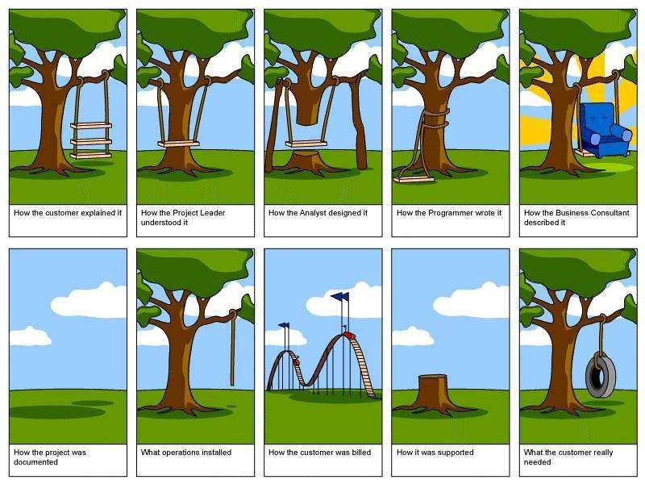
EXERCISE

Slide 6
Standish Group Survey
Failed
28%
46%
Challenged
Succeeded
26%
Based on more than 30,000 projects
Challenged means completed over budget or past the original deadline

Slide 7

Root Causes of Failure
Separation of goal and
function
Separation of business
and technology
Lack of common language
and process
Failure to communicate
and act as a team
Processes that are inflexible to change
Heterogeneous Teams
“When projects fail, it’s rarely technical.”
Jim Johnson, The Standish Group

Slide 8
Challenged Results
Average cost overrun:
189%
Projects restarted:
94%
Average time overrun:
222%
Average functionality delivered:
61%

Slide 9



MSF
Guidance to help organizations be more successful delivering IT Solutions:
  Faster,
  With fewer people,
  Less risk,
  While enabling higher quality results
A collection of principles, processes and best practices that work well together
  Grouped into “Models & Disciplines”

Slide 10
Guidance to help organizations be more successful delivering IT Solutions
A collection of principles, processes and best practices grouped into “Models & Disciplines”
Framework for project management
  Team Model
  Process Model
  Risk Management
A “Framework”
  Can be used in place of a method
  Integrates well with existing processes and procedures
Can be combined with methods
  MSF is a platform for reducing risk
  Pieces of the framework are often useful no matter the situation… look for the best practices
  Use to identify gaps in existing processes or methods

Slide 11
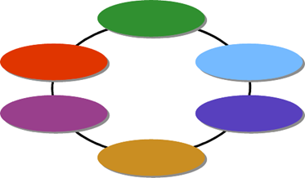




MSF Models and Disciplines
Models
Team
Model
Process
Model
Disciplines
Project
Management
Discipline
Risk
Management
Discipline
Readiness
Management
Discipline

Slide 12
Frameworks:
Supplementing Methodologies
A methodology applies specific directions to a known destination
A framework, like a compass, verifies progress and provides directional guidance
Plum Street
Orange Street
1st Avenue
2nd Avenue
3rd Avenue
.
.
.
.
4th Avenue
.
.
.
N
.
W
E
Smith River
.
.
.
.
.
S
.
MSF

Slide 13
The Origin of MSF
Analyzes results from project teams and product groups
Contrasts these with industry practices and methods
Organizes and consolidates into “people and process” guidance
Microsoft Worldwide Products Groups
Microsoft Consulting
Services
Proven
Practices
MSF
Microsoft
Information
Technology
Group
Microsoft Partners
Evolving since 1993

Slide 14


MSF Essentials
Team Model
Process Model
Great Teams!
Fast, Effective Process!
Project Management Discipline – Getting Results
Risk Management Discipline – Minimize Surprises
Readiness Management Discipline – Anticipate & Grow Skills
Notes:
The foundation of MSF, called MSF Essentials, is based on the following areas:
The MSF Team Model – creating motivated, peer-driven, multidisciplinary, accountable teams to deliver a high quality solution;
The MSF Process Model – an iterative, milestone-based, deliverable-scaleable project lifecycle;
The Microsoft Project Management Discipline – for managing commitments and delivering results;
The Microsoft Risk Management Discipline – to reduce surprises and increase the potential for success;
The Microsoft Readiness Management Discipline – to identify skill gaps and create learning opportunities.
Each of these Models and Disciplines can be applied to all kinds of solution projects, and are enhanced by several subject area best practices. MSF Models and Disciplines each have an associated 20-50 page whitepaper that describes the fundamental processes and best practices of MSF, supplemented by resources such as templates, checklists, whitepapers written by industry experts, and other varieties of guidance.
These papers are currently in development and will be released on the MSF website (http://www.microsoft.com/MSF) when complete (before summer 2002).
MSF Essentials will be the topic of a new two day course that provides an MSF foundation for all other kinds of IT projects and skills to build upon. MSF Essentials takes the common elements of the Principles of Application Development (AD) and the Principles of Infrastructure Deployment (ID) and evolves them with the latest best practices from Microsoft to create a foundation for all of MSF.
AD will evolve into a new two day Software Development course that adds on to MSF Essentials – with no repeated content between.
ID will evolve into a new two day Infrastructure course that adds on to MSF Essentials – also with no repeated content.
MSF Essentials therefore is a pre-req for our next generation Software Development and Infrastructure courses.
Ideally, MSF Essentials is taken by everyone in a project team. Then AD and ID can be taken only by the roles that need them, allowing them to come back to the larger team and working well together because of the MSF Essentials foundation.

Slide 15






Principles of a Successful Team
Shared project vision
Product mindset
Zero-defect mindset
Customer-focused mindset
Willingness to learn

Slide 16
Team Management Model

Slide 17

Team Goals for Success
Satisfied customers
Delivery within project constraints
Delivery to specifications that are
based on user requirements
Release after addressing all known issues
Enhanced user performance
Smooth deployment and ongoing management

Slide 18

MSF Team Model
Program
Management
Product
Management
Development
Team of Peers
User
Experience
Testing
Release
Management

Slide 19
Why These 6 Roles?
Key goals need dedicated equally valued roles:
  Customer Satisfaction: Product Manager
  Project delivered within Project Constraints: Program Manager
  Design and Implementation Based on Specification: Development
  All Issues Known and Addressed: Testing
  Users Performing Better: User Experience
  Deployment, Admin, and Support: Release Management

Slide 20
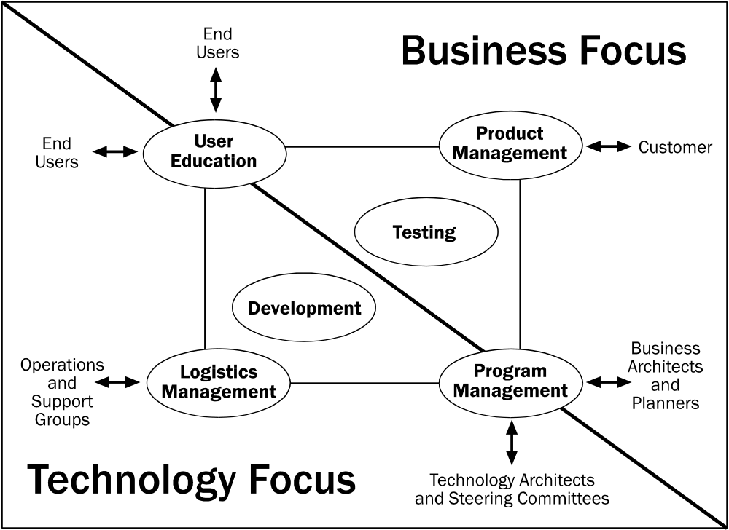
Role Focus and External Coordination

Slide 21









Scaling Roles to Small and Large Projects
Scaling down: Teams with fewer than six people
Team members share roles
  Be sure all perspectives are represented
  Avoid conflicts of interest
Scaling up: Feature and/or function teams
  Feature teams
  Multidisciplinary sub-teams organized around feature sets
  Function teams
  Unidisciplinary sub-teams organized by functional role
User
Experience
Program
Management
Development
Product
Management
Release
Management
Testing
Notes:
MSF project team sizes include average-sized projects (five to twenty people), small projects with four people and less, and many projects with fifty people and beyond.

Slide 22
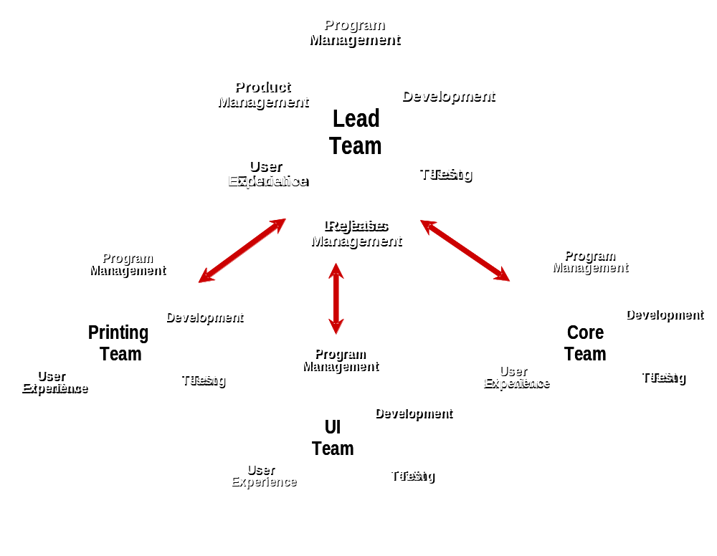
Multiple Feature Teams for Large Projects
Function teams can also be employed.

Slide 23
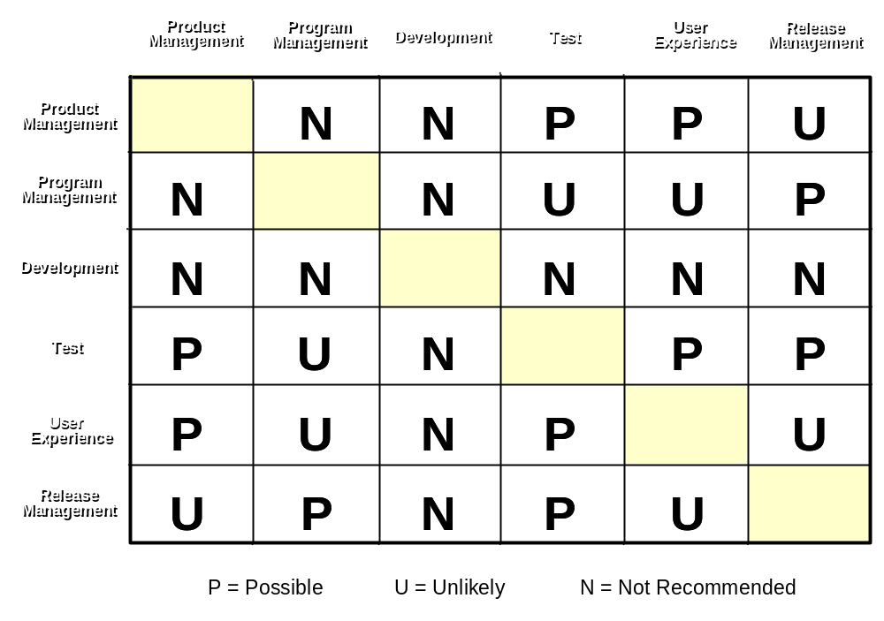
Combining Roles for Small Projects

Slide 24
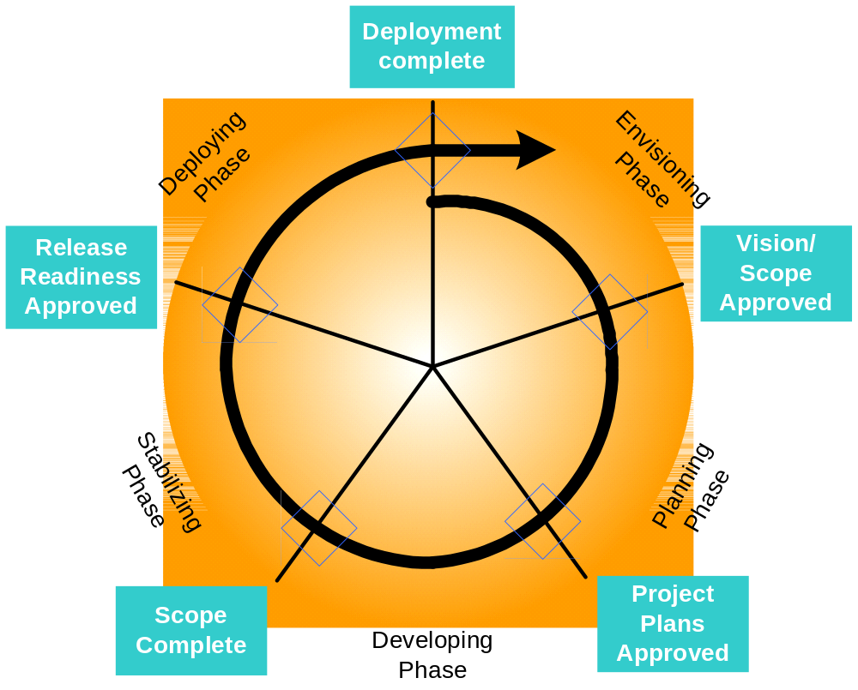

MSF Process Model – Phases & Milestones
Fast,
Effective
Process!
Notes:
Notice that the new Process Model contains five phases instead of four phases as it did with AD and ID. This is to rationalize it into a full-solutions lifecycle – one that embraces the needs of both software and infrastructure – so projects that contain elements of both can work together easily.

Slide 25
MSF Process Principles and Practices
Using versioned releases
Scheduling for an uncertain future
Managing trade-offs
Maintaining a fixed-ship-date mindset
Managing risk
Breaking large projects into manageable parts
Driving process with milestones
Using bottom-up and milestone-based estimating
Performing daily builds
Conducting post-project reviews

Slide 26
Using Versioned Releases
Force closure on project issues
Set clear and motivational goals with all team members
Manage the uncertainty and change in project scope
Encourage continuous and incremental feature delivery
Enable shorter time to market
Version 3
Version 2
Version 1
Functionality
Time

Slide 27

Scheduling for an Uncertain Future
Create “living” documents
  Baseline Early -- Baseline planning efforts begin as early as possible for an earlier development start
  Freeze Late -- Consider documents as dynamic and subject to change
Schedule highest-risk and “must-have” features in early milestones
  Address top issues first
  Ensure inclusion in final product
Schedule risk-based buffer time
  Do NOT spread across all tasks (beware Parkinson’s Law)
  Add as separate critical-path task, plan last milestone as “nice-to-have” features
Functional Specifications
Vision Document
Project Plans
Project Schedule
Risk Management Document
Living Documents

Slide 28

Project Trade-off Matrix
Resources
Schedule
Features
Fixed
Chosen
Adjustable
Resources
Microsoft’s
Typical
Approach
Schedule
Feature Set
Fill
in the
blanks
Given fixed ___________,
we will choose a ___________,
and adjust _________ as necessary.
Notes:
Notice that the Trade off Matrix has gone through some wording changes (tops of the columns) – making it easier to understand and explain to others.

Slide 29
Fixed-Ship-Date Mindset
A fixed-ship date mindset means that a team treats its projected ship date as unchangeable
  Essentially the schedule side of the triangle is considered fixed
  The team cannot use this side of the triangle for making corrective decisions unless no other option is available.
Forces creativity by requiring the team to implement features in as timely a manner as possible and removing the option of delaying the ship date
Prioritizes tasks according to importance -- If the team needs to drop features in order to make the ship date, it delivers those most important to the customer)

Slide 30
Empowers the team by providing an effective decision-making tool -- The team makes decisions on the basis of how they will affect the team’s ability to deliver on the fixed ship date.
Provides a motivational goal for the team
  “There’s a thousand different variables that go into shipping a product, the feature sets, the people working on it, how long they’re working, a bunch of stuff. All we’re trying to do is fix one of them, just one. Of all the thousand variables, let’s just fix one variable and let’s vary the other 999 variables. When you fix the ship date, you force creativity, you force decisions.”

Slide 31
Risk Assessment
Risk assessment is a decision-making resource
Analysis should be comprehensive and include: identification, probability, impact, exposure, mitigating actions, contingency plans, and triggers
Assessment should be initiated as an ongoing process during any project where significant risk factors have been identified, with customer-visible risk document published with status report
Question:
What’s a risk assessment? When should we consider doing them for a project?
A Risk realized (100% probability) becomes an Issue.

Slide 32


Microsoft Risk Management
Identifying, analyzing, and
addressing risk proactively
To manage risk proactively
Anticipate problems vs. Fixing them when they occur
Address root causes vs. Addressing symptoms of
the cause
Prevent and minimize risk vs. Reacting to consequences
through mitigation
Prepare for consequences vs. Reacting to a crisis
to minimize impact
Use a known and vs. Using an ad-hoc process
structured process
Minimize
Surprises

Slide 33
Risk Considerations and Goals
Areas for consideration during risk assessment:
Research. Do we know enough about this risk? Do we need to study the risk further to acquire more information and better determine the characteristics of the risk before we can decide what action to take?
Accept. Can we live with the consequences if the risk were actually to occur? Can we accept the risk and take no further action?
Manage. Can the team do anything to mitigate the impact of the risk should the risk occur?
Avoid. Can we avoid the risk by changing the scope?
The three risk management goals are to:
Reduce the probability of occurrence;
Reduce the magnitude of loss; or
Change the consequences of the risk.

Slide 34
The Milestone-driven Process
Types of Milestones
  Major—culminates in a deliverable, and transitions between phases and transitions responsibility across roles
  Interim—indicates early progress and segments large work efforts into workable pieces
Function of Milestones
  Used as review and synchronization points
  Used to assess progress and to make mid-course corrections
  Represents team and customer agreement to proceed
MSF defines specific major milestones that are generic enough for any type of IT project.

Slide 35
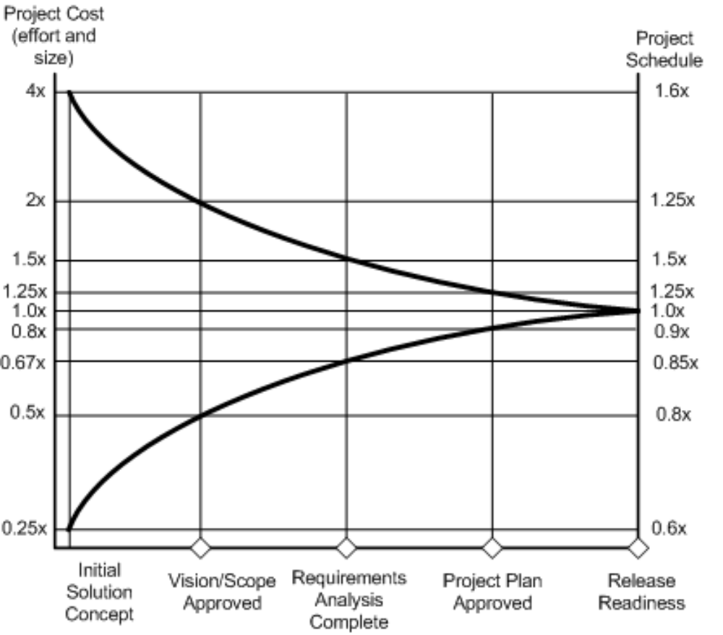
Milestone-Based Estimating –
“Cone of Uncertainty”

Slide 36
Daily Builds – A Way of Life at Microsoft
“Building” an executable program from up to thousands of different files
Microsoft software development teams practice the “daily build and smoke test” process in which they compile every file, combine them into a single executable program, and put it through a “smoke test” to see if it runs.
  A smoke test exercises the entire system to expose any major problems
  The daily build is not valuable unless accompanied by a smoke test
  Performing daily builds and smoke tests provides a number of important benefits
    Minimizes code integration risk by identifying incompatible code early and allowing the team to make debugging or redesign decisions
    Supports improved defect diagnosis, making it easier to pinpoint why the product may be broken on any single day
    Reduces the risk of low quality

Slide 37
The team must perform the daily build and smoke test each day—not weekly or monthly—in order to produce the greatest benefits
  The software must work or else the build is viewed as broken and must be fixed
  Performing daily builds and smoke tests is like trying to ship a product every day, which enforces a sense of discipline upon the team.
Standards for daily builds and smoke tests vary from project to project, but at a minimum they should include:
  Compiling all files and components successfully.
  Linking all files and components successfully.
  Finding no “showstopper” bugs that would make the program hazardous to operate or prevent it from launching.
  Passing the smoke test.

Slide 38
Continuous Improvement
Post-project reviews ensure continuous learning
  What went well?
  What went poorly?
  What should be done differently?
  Recommendations for the future
Purpose is to facilitate individual and organizational learning
Post-project meetings can also be conducted at key milestones of long projects
The objective is to LEARN from the experience by facilitating a very open, blame-free discussion of project successes and mistakes.

Slide 39
Standard MSF Deliverables
I. Envisioning: “Vision Approved” Milestone
Vision document
Risk assessment
Project structure document
II. Planning: “Scope Complete” Milestone
Functional specification
Risk assessment
Project schedule
Operation and support information systems
  Procedures and processes
  Knowledge base, reports, logbooks
III. Developing: “Scope Complete” Milestone
Frozen functional specification
Risk management plan
Source code and executables
Performance support elements
Test specification and test cases
Master project plan and master project schedule
IV. Stabilizing: “Release” Milestone
Golden release
Release notes
Performance support elements
Test results and testing tools
Source code and executables
Project documents
Milestone review
V. Deploying: “Deployment Complete” Milestone
Documentation repository for all versions of documents, load sets, and code developed during the project.
  Project close-out report
    Final versions of all project documents
    Customer/user satisfaction data
    Definition of next steps

Slide 40
Process Model

Slide 41
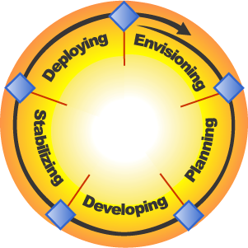
MSF Process Model
Deployment
Complete
Release Readiness
Approved
Vision/Scope Approved
MSF
Scope Complete
Project Plans Approved

Slide 42
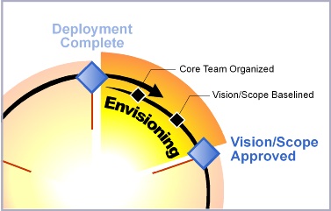
Envisioning Phase
Deliverables
  Vision/scope
  document
  Project structure
  document
  Initial risk
  assessment document

Slide 43

Setting the Target
  Alice: “Would you tell me please, which way I ought to go from here?”
  Cat: “That depends a good deal on where you want to get to.”
  Alice: “I don’t much care where …”
  Cat: “Then it doesn’t matter which way you go.”
  Alice in Wonderland
  by Lewis Carroll

Slide 44

Using Versioned
Releases to Keep Up With the Curve
Technology
Business
Rate of
Change
Versioned
Releases
Obsolete
Solution
Traditional Release Study and Analysis
Time
in Six-Month Cycles

Slide 45
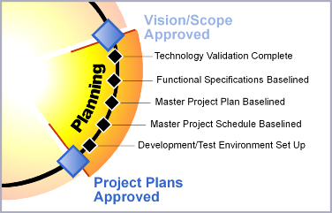
Planning Phase
Deliverables:
Functional
specifications
Master project
plan
Master project
schedule

Slide 46



Defining the Scope
Envisioning
Resources
Schedule
Features
Planning
Resources
Schedule
Features

Slide 47
Cost of Fixing a Poorly
Designed Solution
Relative Cost
100
80
60
40
20
Envisioning
Planning
Developing
Stabilizing
Deploying
Project Phase

Slide 48
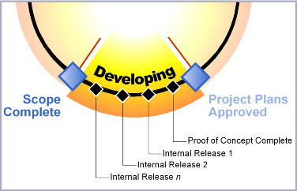
Developing Phase
Deliverables:
Solution code
Build images
Training materials
Documentation
  Deployment processes
  Operational procedures
  Support and troubleshooting
Marketing materials
Updated master plan and schedule

Slide 49
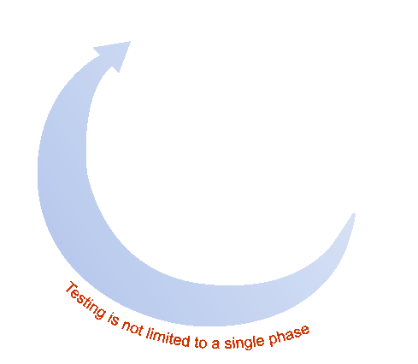
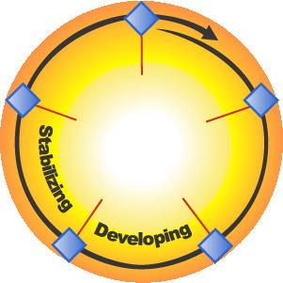
Testing the Solution
Testing is part of the build cycle, not a standalone activity
Release Readiness
Approved
MSF
Scope
Complete
Project Plans
Approved

Slide 50
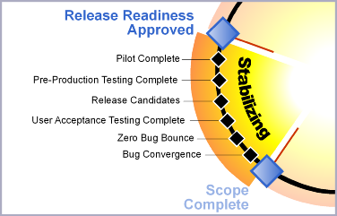
Stabilizing Phase
Deliverables:
Pilot review
Release-ready versions:
  Source code and
  executables
  Scripts and installation
  documentation
  End-user help and
  training materials
  Operations documentation
  Release notes
Testing and bug reports
Project documents

Slide 51
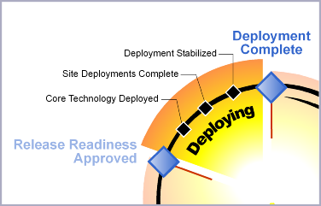
MSF Deploying Phase Milestones and Deliverables
Deliverables
  Operations and
  support information
  systems
  Repository of all
  versions of docs,
  load sets, configs,
  scripts, and code
  Project close-out report

Slide 52
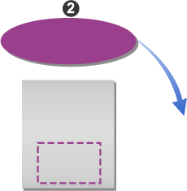
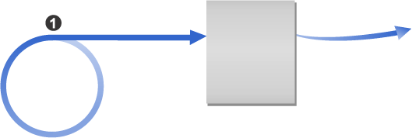
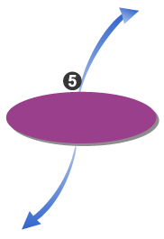
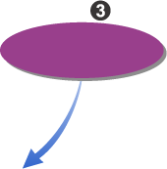
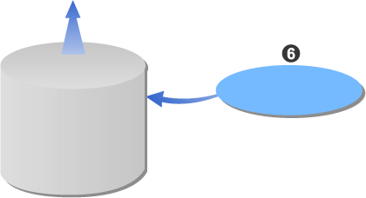
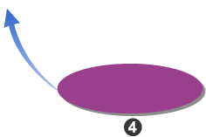
MSF Risk Management Process
Analyze and
Prioritize
Risk
Statement
Identity
Master
Risk List
Control
Plan and
Schedule
Top n
Risks
Learn
Track and
Report
Risk
Knowledge Base,
Concepts,
and Processes

Slide 53
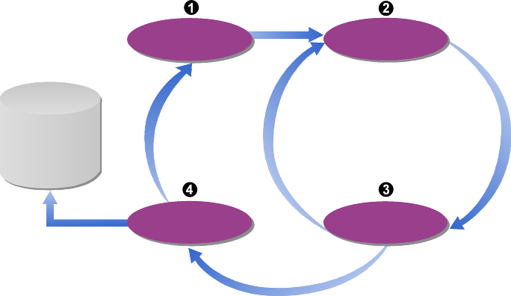
MSF Readiness
Management Discipline
Use proactive vs.
reactive approach
Treat readiness gaps
as risks
Capture and manage
team knowledge
Focus on individual,
not organizational readiness
Remember – the need for team readiness spans the life of the project
Define
Assess
Knowledge
Skills
Abilities
Evaluate
Change

Slide 54
For More Information
www.microsoft.com/msf

Slide 55
Software Project Management (SPM)

Slide 56
Software Project Management
Goals
What We Try To Avoid
Software Project Manager Competencies
Project Management Knowledge Areas
Project Management Integration
  Initiating
  Planning
  Executing
  Monitoring & Control
  Change Control
  Closing

Slide 57
Software Project Management
Goals
  Planning, Organizing, Staffing, Directing, Monitoring, Controlling, Innovating, Representing.
Activities
  Feasibility Study, Planning, Project Execution (Requirement Analysis, Specifications, Coding, Implementation/Installation, Maintenance/Support)
Challenges Specific for Software Projects
  Invisibility, Complexity, Non Consistency, Flexibility
What We Try To Avoid
  Management View: POOR estimates, Plans, Quality Standards and Measures, Guidance, Decision Making, Role Definition, Progress Tracking, Success Criteria
  Project Team View: POOR Specification, Understanding IT Role, Application/Business Knowledge, Standards, Documentation, Late Deliveries, Communication, Duplicate Work Control, Technical Expertise, Changing Requirements, Changing Software Environment, Quality Control, Hand-On Management, Training, Deadline Setup.

Slide 58
Software Project Management
3Ps: Product-Project-People
Competencies of Software Project Manager
  Product: Reviews Criteria, Process Standards, Product Requirements and Customer Environment, Evaluation of Alternative Approaches, Managing Requirements, Managing Subcontractors, Assess Difficulties Risks Cost and Schedule, Select Methods and Tools, Tailor Processes and Standards, Master Software Development Cycle.
  Project: Build Work Breakdown Structure (WBS), Identify Key Components, Cost Estimate, Effort Estimate, Managing Risks, Monitor Development, Create Schedule and Key Milestones, Select Progress Monitoring Metrics, Project Management Tools, Track Compliance of all the project teams, Monitor Progress.

Slide 59
Software Project Management
  People: Evaluate Performance, HR legal issues, Effective meeting, Interaction and Communication, Leadership and Coaching, Managing Changes, Conflict Resolution and Negotiations Skills, Planning Careers, Presenting Skills, Recruiting, Selecting Highly Competence Team, Teambuilding

Slide 60
Programme Management/Project Integration Management
(in red – PMI’s 7 Project Integration Management Processes)
Initiating
  Project charter
  Preliminary scope statement
Planning
  Project Evaluation
  Technical Planning and Approach Selection
  Software Prototyping.
  Project Stakeholders, Life Cycle and Organizational Influence.
  Project Management Plan
Monitor and Control Project Execution
Monitor and Control Project Work
Change Control
Close Project

Slide 61
Project Charter
The Document That Formally Authorizes the Project. Issued by the project sponsor that can authorize the needed funding.
Link the project to the ongoing activities of the organization.
The Project Charter Will Follow:
  Need Assessment, Feasibility Study, Preliminary Plan
  Selection Criteria ( Cost Benefit, Scoring Model Etc.)
  Expert Judgment ( Consultants, Professional and Technical Associations, Stakeholders, Etc.)
  Selection of Project Management Information System and Management Methodology
  Existing Process Methods in the Organization
  Enterprise Factors ( HR, Infrastructure, Company Culture, Etc.)

Slide 62
Preliminary Scope Statement
Main Topics
  Characteristics and Boundaries of the project
  Associated Products and Services.
  Methods of Acceptance
  Scope/Change Control
Detailed Content
  Objectives, Requirements(functional, Quality, resource), Characteristics, Deliverables
  Acceptance Criteria, Constrains, Assumptions, Risks
  Organization, Milestones, WBS(work breakdown structure), Initial Cost Estimate
  Management Tools, Approval Requirements

Slide 63
Project Evaluation
Objectives
  Select Project against STRATEGIC, TECHNICAL and ECONOMIC criteria.
  Use Cost Benefit Techniques to choose a project among other projects proposals.
  Evaluate risks and strategies to minimize potential costs.
Cost: Development, Setup, Operational
Benefits: Direct, Assessable Indirect, Intangible

Slide 64
Cost Benefit Analysis Methods
Cash Flow Forecasting (to secure funding)
Net Profit
Payback Period
Return On Investment (ROI) - (Average annual profit/total investment*100)
Net Present Value (NPV)
  NPV = sum(PV)
  PV(t) = value in year t/(1+r) exp(t)
Internal Rate of Return (IRR) – The percentage discount that will zero the NPV

Slide 65
Risk Evaluation
Identification and Ranking (importance, likelihood)
Risk and NPV ( add risk factor to the discount rate)
Risk Profile Analysis (change the risk factor and recalculate the costs. Evaluate the the sensitivity to the change. Focus on highly sensitive risks)
Decision Trees – Evaluate alternatives by multiply the probability of occurrence by expected cost to evaluate expected value.

Slide 66
Technical Planning and Approach Selection
Technology Planning:
  Object Oriented, Structured Programming, Application Builder, Automated Testing Tools, Etc.
  Parameters to consider: Data/Process Oriented, Standard Operating Environment (SOE), Product/Application Specific, Etc
Approach Selection:
  Structured (e.g. OO) VS Rapid Application Development (e.g. Prototyping)
  Process Model: Waterfall VS V-Process VS Spiral Model
  Incremental Delivery

Slide 67
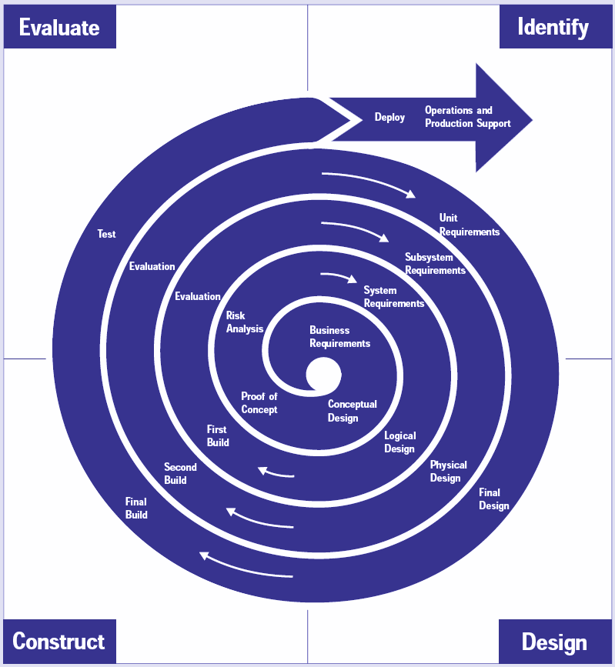
Spiral Software Development Model

Slide 68
Software Prototyping.
Classification: Throw-away, Evolutionary
Advantages: Clarification of Partially Documented Requirements, Improve Communication, Improve Users Involvement, Reduce Needs for Documentation, Increase competence and Reduce Inconsistencies, Rapid Development Tool,Reductions of Changes Requirements during development
Disadvantages: Additional Expense, Implies Development One Site, May weaken standards and control, Misunderstanding the role of prototyping by the users.

Slide 69
Project Stakeholders, Life Cycle and Organizational Influence.
Stakeholders – Individuals and Organizations that are actively Involves in the Project, Their Interests may be Effected by the Project or Influence the Project Objectives and Outcomes.
Positive and Negative Stakeholders
Key Stakeholders – Project Manager, Customer/User, Performing Organizations, Project Team Members, Project Management Team, Sponsor(provide budget), Influencers, Project Management Office (PMO)

Slide 70
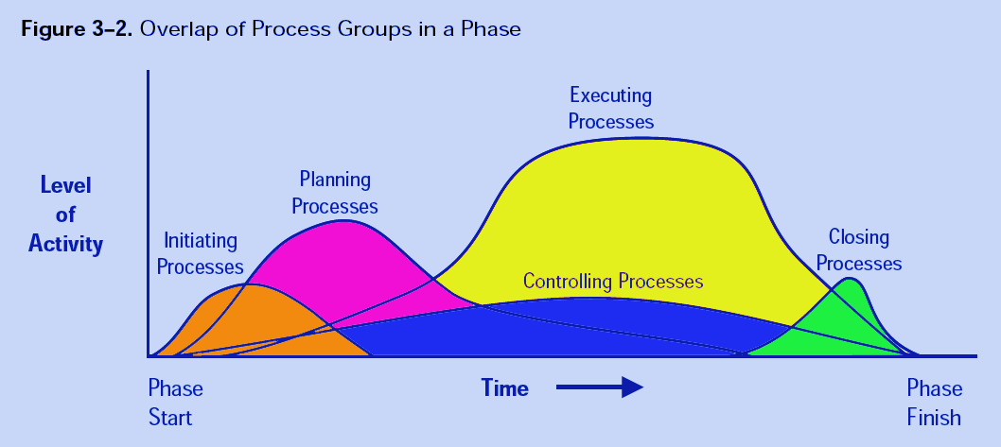
Life Cycle

Slide 71
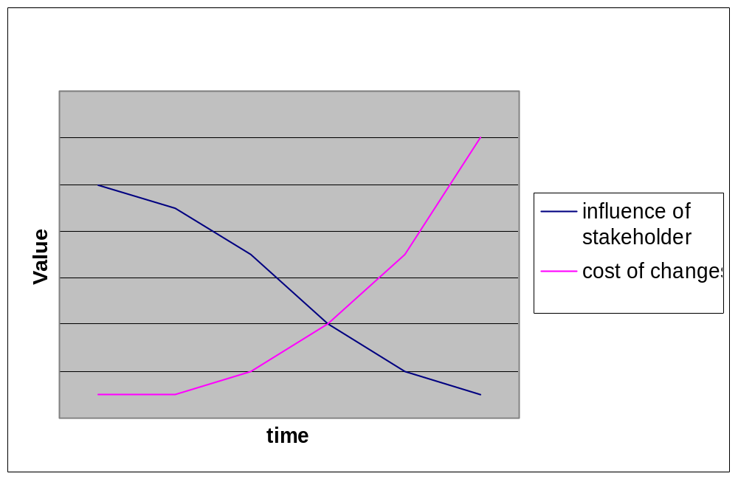
Stakeholders Influence Over Time

Slide 72
Project Management Plan
Actions necessary to define, integrate, and coordinate all subsidiary plans into the overall project plan.
Define Change Control procedures, Key Management Reviews and Open Issues Resolution, Communication Technique among Stakeholders.

Slide 73
Monitor and Control Project Execution
Perform activities and Spend funds to accomplish project objectives
Train and manage team members
Vendors selection and Management
Implement Methods and Procedures
Obtain and Manage Resources
Create, Control and Verify Project Deliverables
Manage Risks
Manage Changes
Report Project Status (cost, schedule, technical and quality progress, forecasting)
Implement Improvement Activities and Lessons Learned.

Slide 74
Monitor and Control Project Work
Compare actual project performance against project plan
Monitor risks and appropriate actions needed.
Monitor and Document On Going Project Products and Documentation
Maintain Information Base in order to Provide Project Status Report, Progress Measurements and Forecasting
Update Cost and Schedule Information
Monitor Implementation of Approve Change Requests

Slide 75
Change Control
Verify implementation of approved changes
Review and Approve requested Changes
Manage the Flow of Change Requests
Control and Update the Cost , Budget, Schedule, Staffing and Quality Requirements based upon the Approved Changes.
Coordinate Changes Across the Entire Project
Document the Impacts
Configuration Management Tools with Change Control:
  Evaluation of the Value and Effectiveness of the Requested Changes.
  Communicate All Changes to Stakeholders
  Identify and Consider The Impact of Each Change to the Project

Slide 76
Close Project
Administrative Procedure:
  Stakeholders Approval
  Verify that the project met all the requirements and all the deliverables was provided and accepted.
  Completion and Exit Criteria have been met.
Contract Closure Procedures:
  Formally Close all contractual obligations and activities
Final acceptance
  Formal acceptance and handover of final product/service
Closure Documentations
  Formal Acceptance Document
  Updates Project Files
  Project Closure Document (Completion, Transfer or Termination Reasons)
  Historical Information (Lessons Learned, Update Corporate Knowledge Repository for use in future projects)

Slide 77
THANKS

